Slide 1


Tin sinh học ứng dụng (Applied Bioinformatics)
Phuc Loi Luu, PhD
Luu.p.loi@googlemail.com
Loi.lp@pacificinformatics.com.vn
22 July 2023

Slide 2
Content
Class member introduction
Curriculum
Projects and important dates
Evalutation for the course
How my lecture work?
Linux environment and command lines
Awk

Slide 3

Class member introduction
Bạn phẻ không?
Phẻ! Cảm ơn bạn. Còn bạn?

Slide 4


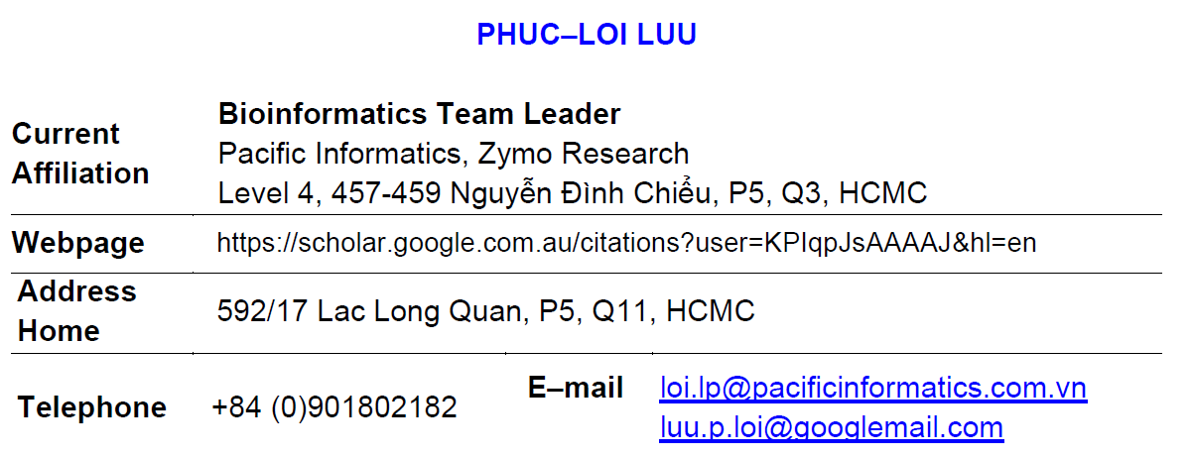
PERSONAL INTRODUCTION

Slide 5
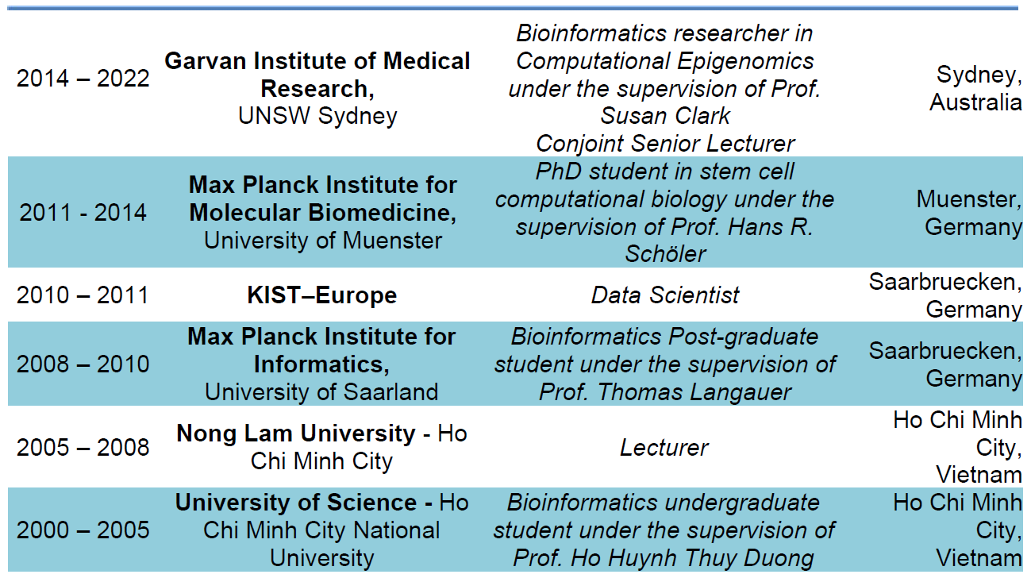
EDUCATION AND PROFESSION

Slide 6
Curriculum Applied Bioinformatics 2023
Linux OS, Linux command lines, basic bash script and awk (22 July)
Basic R, statistics with R, and data visualization with R (29 July)
Review basic molecular biology, the human genome, gene annotation, and the other databases
Basic GWAS: case/control and quantitative traits
NGS and upstream analysis for DNA-seq
Downstream analysis for DNA-seq
Introduction to bulk RNA-seq, library types, and experiment design
PolyA bulk RNA-seq analysis
Long non-coding bulk RNA-seq analysis
Presenting group projects

Slide 7
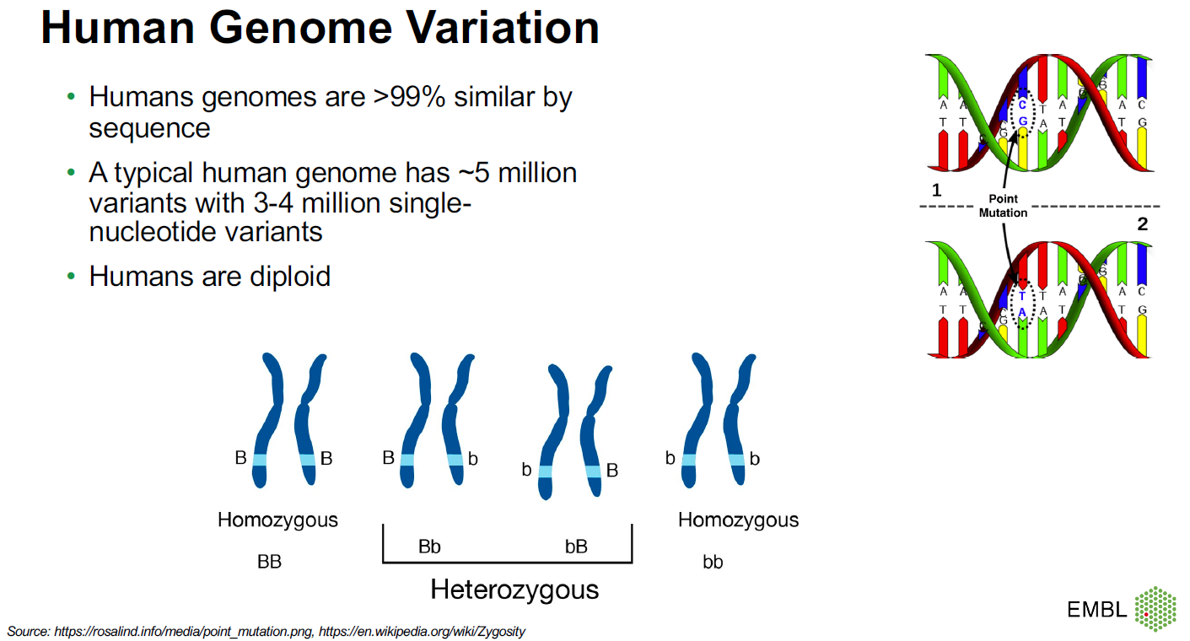

Slide 8
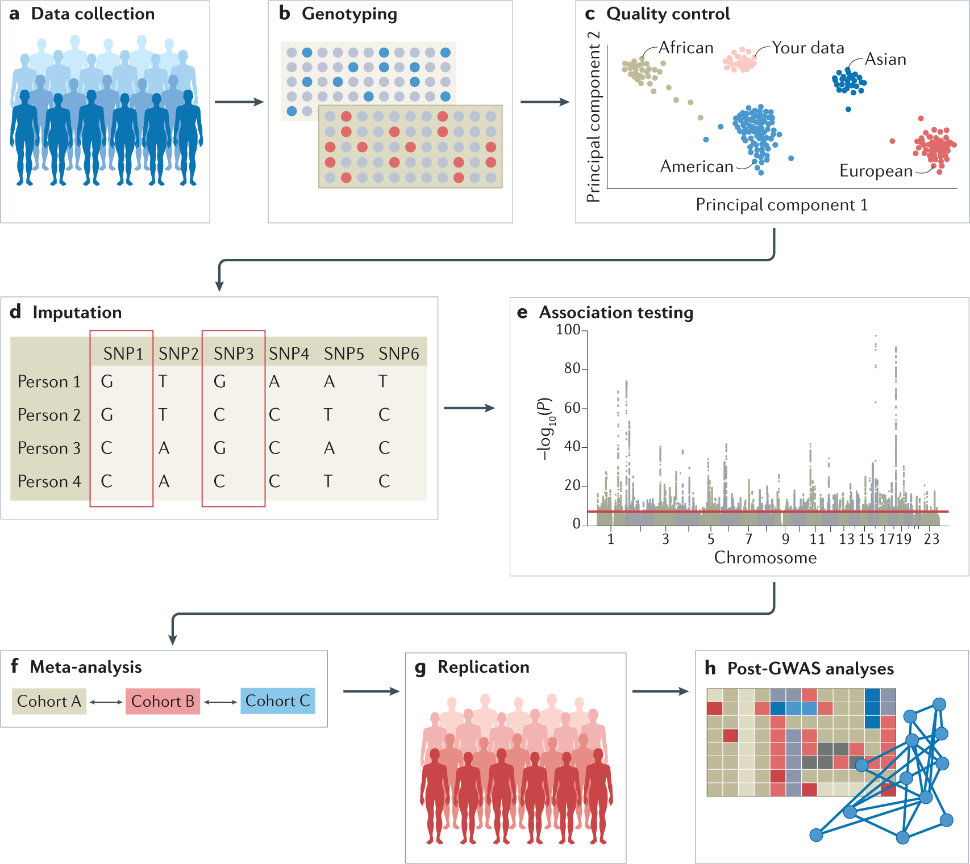
Genome-wide association studies (GWAS)
https://www.nature.com/articles/s43586-021-00056-9

Slide 9
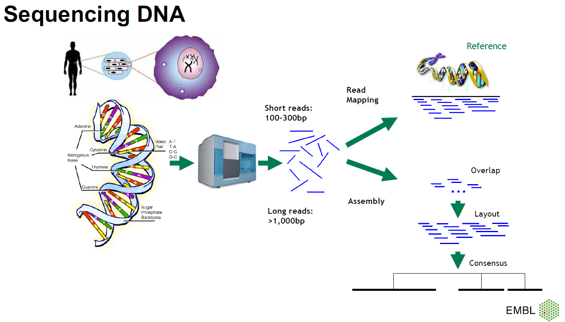

Slide 10
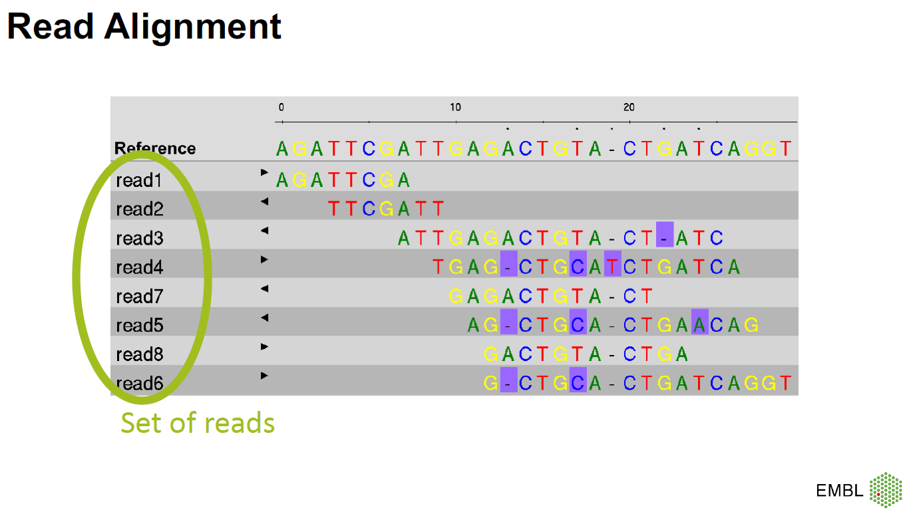

Slide 11
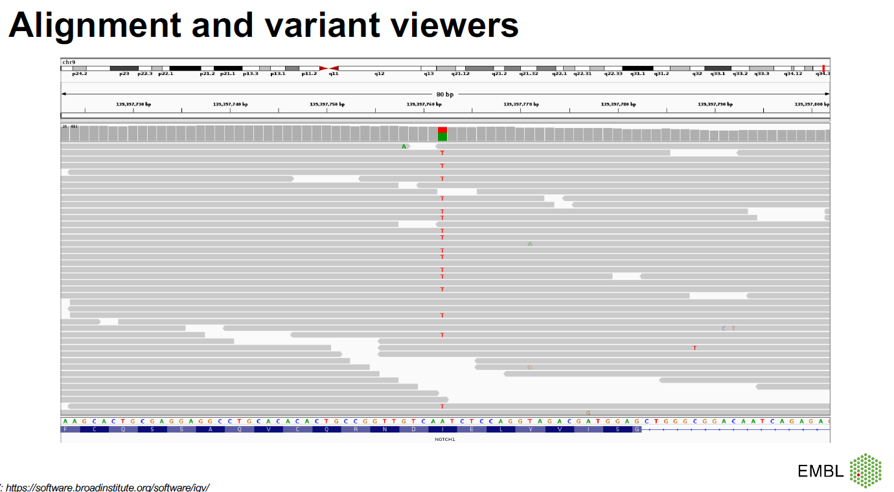

Slide 12
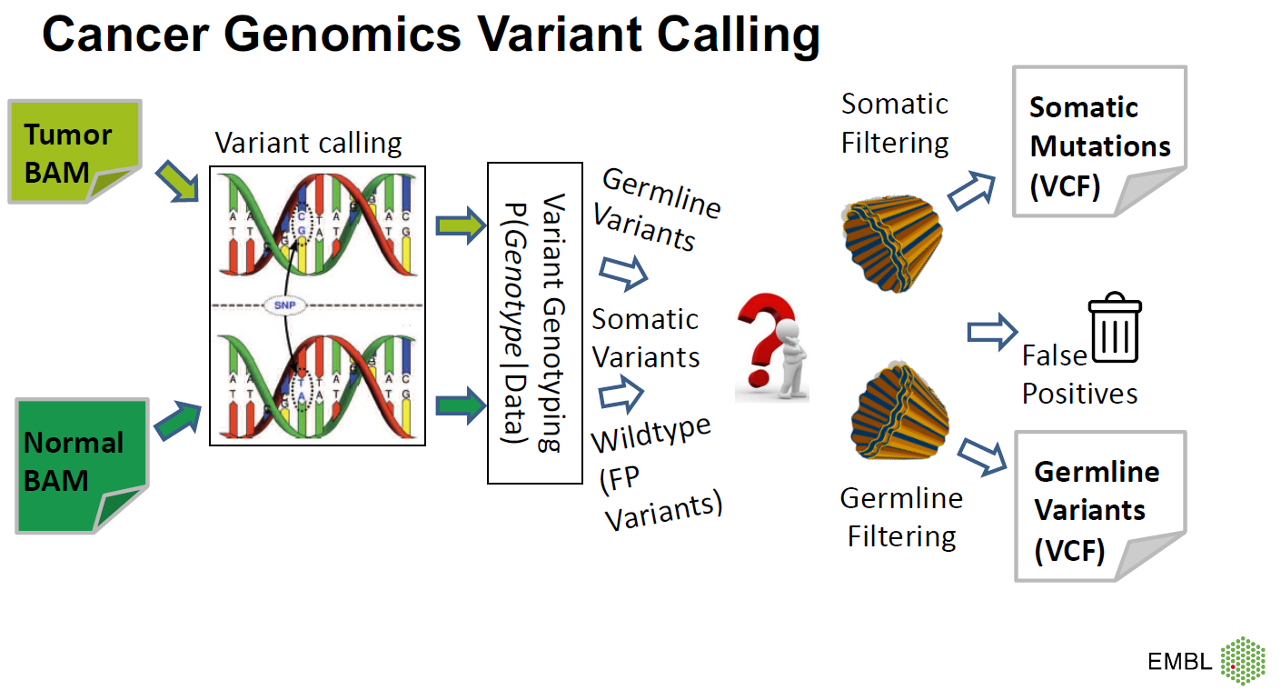

Slide 13
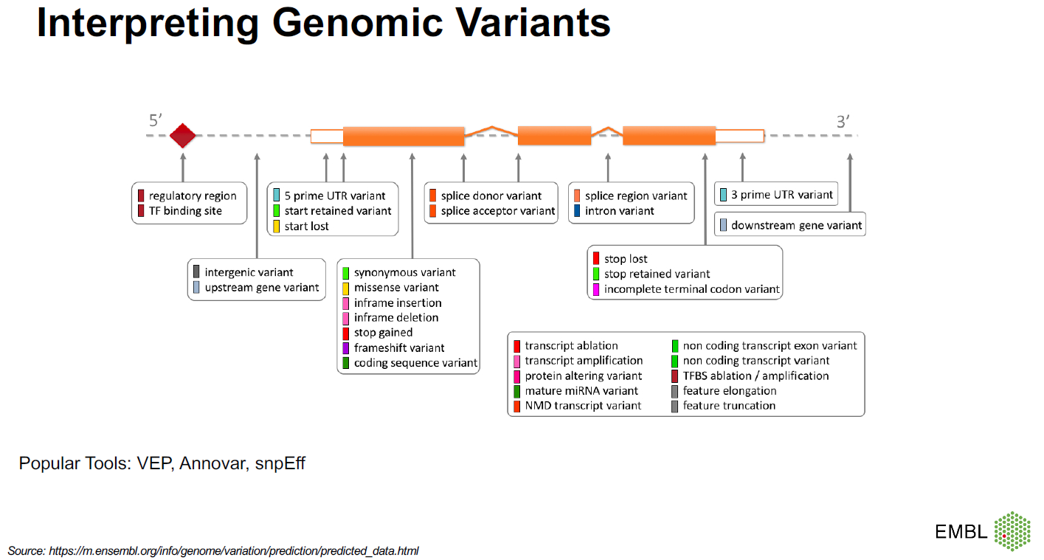

Slide 14
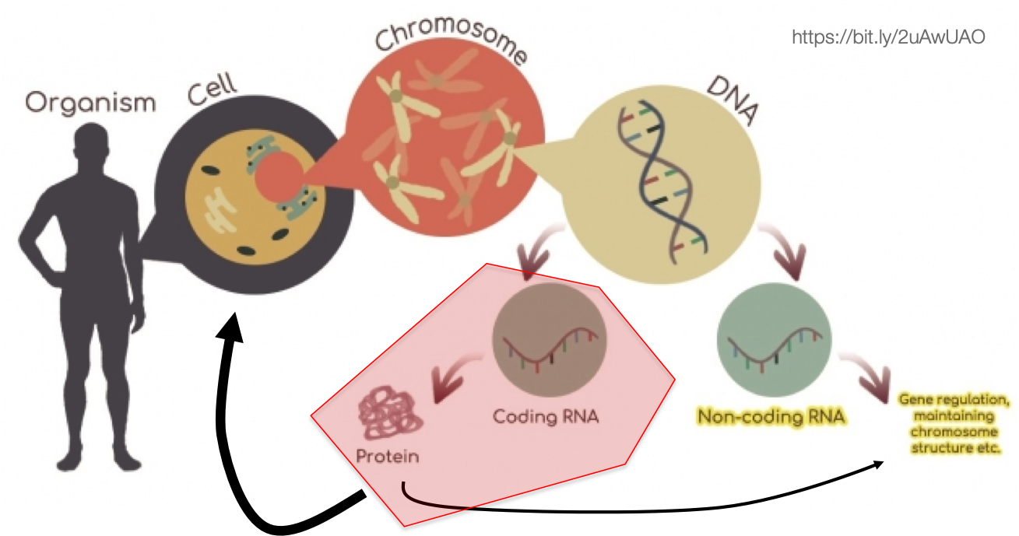
Bulk RNA-seq
mRNA amounts are used as a proxy for the amounts of their corresponding proteins within a given tissue.

Slide 15
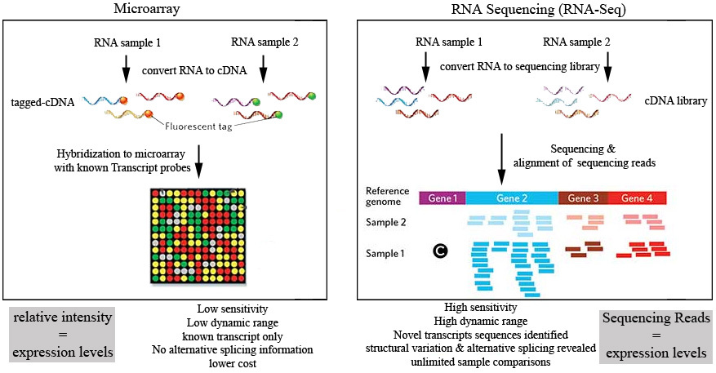
Microarray vs RNA-seq
https://www.otogenetics.com/rna-sequencing-vs-microarray/

Slide 16
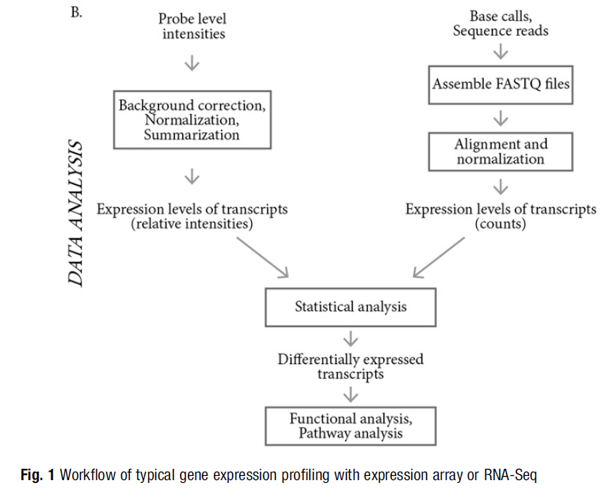
10.1007/978-1-4939-7834-2_2

Slide 17
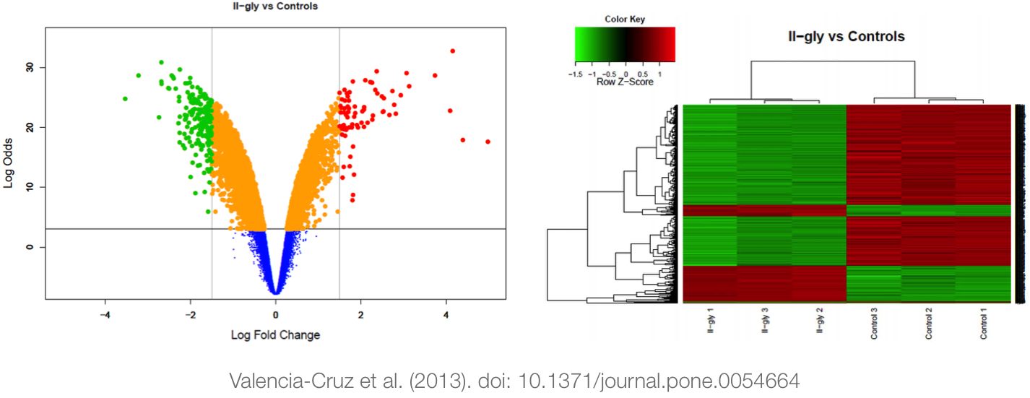
Differential gene expression (DGE)

Slide 18
Projects and important dates
No | Project | Aim | Requirement | Group
1 | Build up breast cancer gene panel | Build, examine genome structure, processing two datasets | - Programming bash and R - Moclecular biology | A, B, C
2 | Processing a gene panel sequencing dataset of a panel cancer | Processing and interpretation of the result | - Programming bash - Moclecular biology | D,F
3 | Processing a exome sequencing dataset of a cancer | Processing and interpretation of the result | - Programming bash - Moclecular biology | G,H
4 | Clinical NIPT test from Gene Solution | Understanding processing and interpretation of the result | - Programming R Moclecular biology Clinical background | I
5 | Pharmaco-genomics test from Gene Story | Understanding processing and interpretation of the result | - Programming R - Moclecular biology - Clinical background | M
6 | The Contribution of Germline Pathogenic Variants in Breast Cancer Genes to Contralateral Breast Cancer Risk in BRCA1/BRCA2/PALB2-Negative Women | Understanding the artical and interpretation of the result | - Moclecular biology - Clinical background | K
https://pdfs.semanticscholar.org/82f0/97db6a57a606b87be2fe01ccf2bf3bd2e326.pdf

Slide 19
Do we need to install and learn Ubuntu and programing?
Không học Ubuntu và lập trình được không?
Được nhe!

Slide 20
Do we need to install and learn Ubuntu and programing?
Không học Ubuntu và lập trình được không?
Được, nhưng như có chân mà ngồi xe lăn!

Slide 21
Evalutation for the course
Presentation date (final exam): 30 September 2023
30 min each group
5-10 questions each student
Report (20) + Presentation (20) + Slide (10) + Questions for the presentation (25) + Questions for the all the lectures (25)

Slide 22
How does my lecture work?
Start at 8:00 AM every Saturday from 22 July to 30 September 2023 (9 week, one week off – 2 September - National holiday)
15 min oral test at the begin of the lecture
Use Skype to record the lecture via group https://join.skype.com/shHtfbx08aaj
Upload to youtube (you can review lecture at home)
Looking for volunteers to take care lecture videos (Cut the lecture into 10 min clips): Gấm, Thanh and Tú
Time breaks in a lecture (8:30-8:40 AM, 9:50-10 AM, 10:50-11 AM)
No attendance checking

Slide 23
No attendance checking
Nghỉ học được không bạn?
Được nhe!

Slide 24
No attendance checking
Nghỉ học được không bạn?
Nhưng khó đậu nhe!

Slide 25
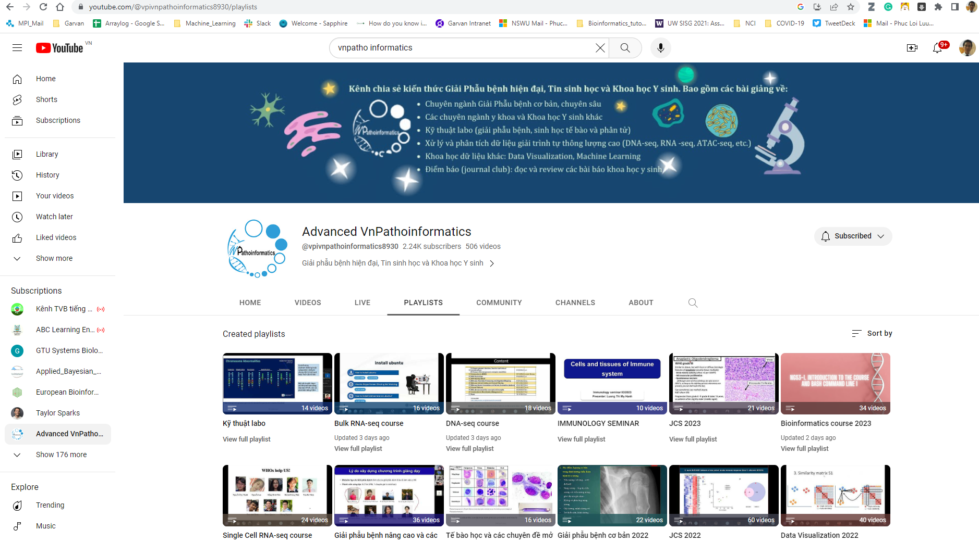
https://www.youtube.com/@vpivnpathoinformatics8930/playlists

Slide 26
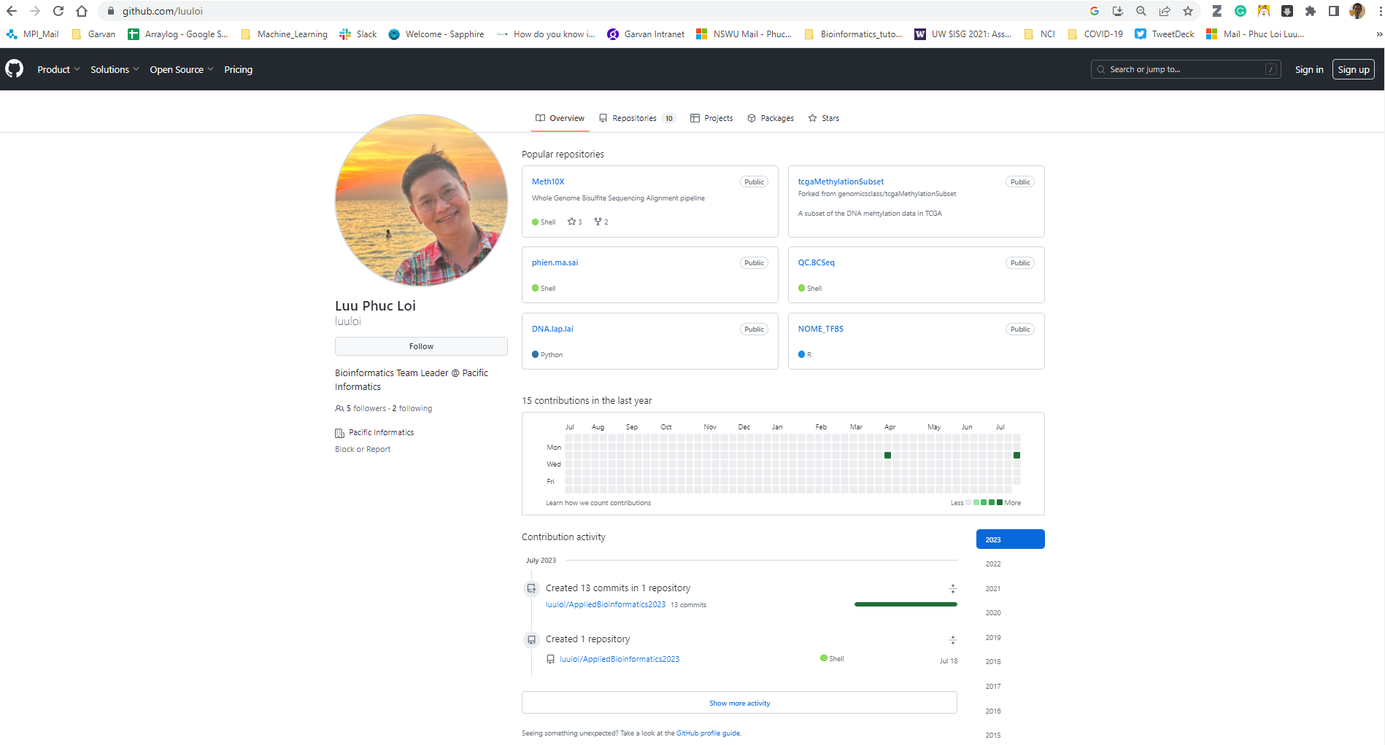
https://github.com/luuloi

Slide 27
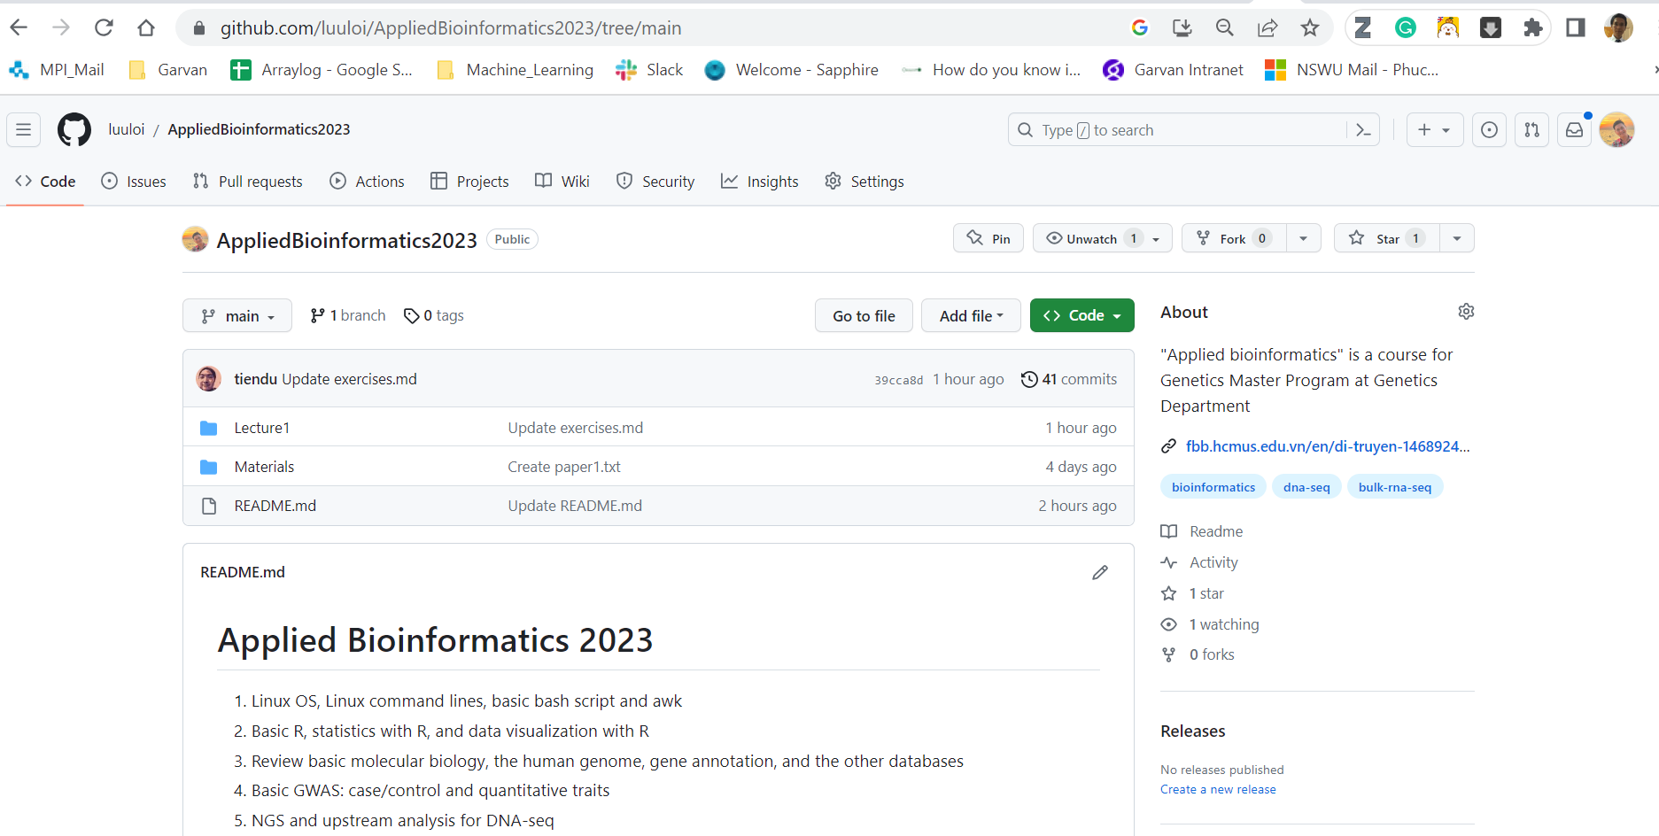
https://github.com/luuloi/AppliedBioinformatics2023/tree/main

Slide 28
